Slide 1
WEC - Programming Group 5
Jack Gordon and Rayed Hamayun

Slide 2

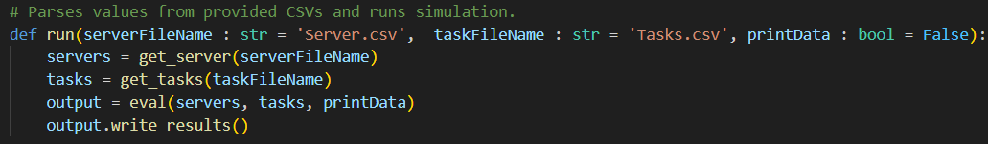
General Outline / Main.py
Main
Parse CSVs
Simulate
Write CSV
Notes:
On the high level, our program first parses the CSVs, then simulates with our algorithm, and finally writes to a CSV result.

Slide 3
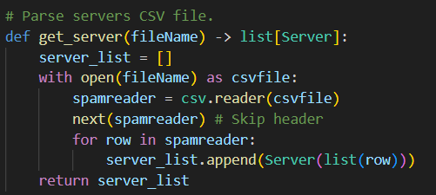
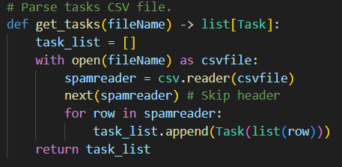
Parsing
Notes:
Our parsing is straightforward. We go through the file and, row by row, convert it into our desired datatype. We have a Server and Task data type.

Slide 4
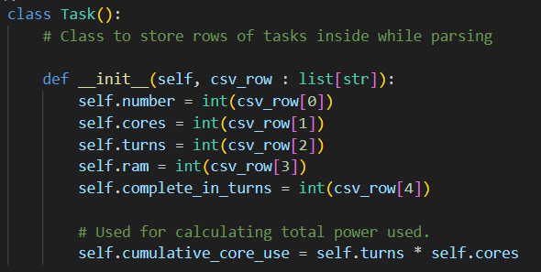
Task.py
Task
Number
Cores
Turns
etc.
Notes:
Our task data type just has all the values we expect from a task.

Slide 5
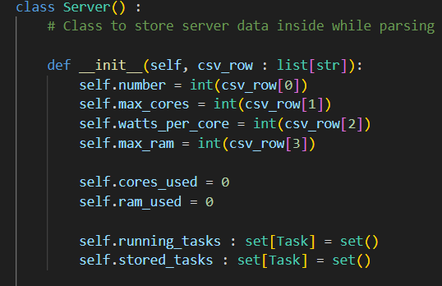
Server.py
Server
Running Tasks
Stored Tasks
Notes:
Our server data type has the server’s aspects, in addition to storing the tasks we are currently running and the tasks we have stored.

Slide 6
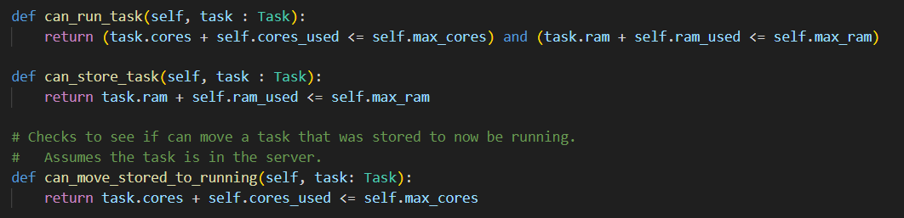
Server.py
Notes:
We want to check if we can run a task, are able to store it, and if we’re able to move the task away from running. The implementation does that by checking the cores and/or ram.

Slide 7
Server.py
Task
Server
Task
Run Task
Remove Task
Running Tasks
Stored Tasks
Move stored to Running
Task
Store Task
Notes:
We have a few other things we’d like to do, like running tasks in a server, storing them, removing them, and moving them around.

Slide 8
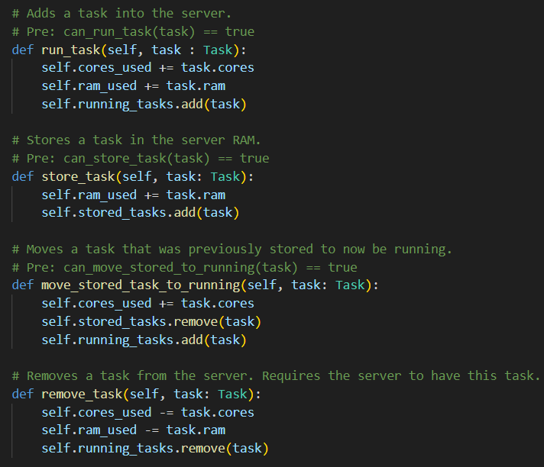
Server.py
Notes:
This is the implementation.

Slide 9
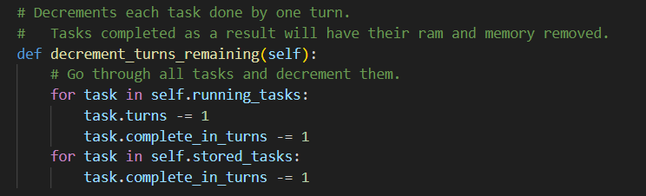
Server.py
Notes:
We want to be able to decrement the turns remaining as we advance turns, so we have code for that.

Slide 10
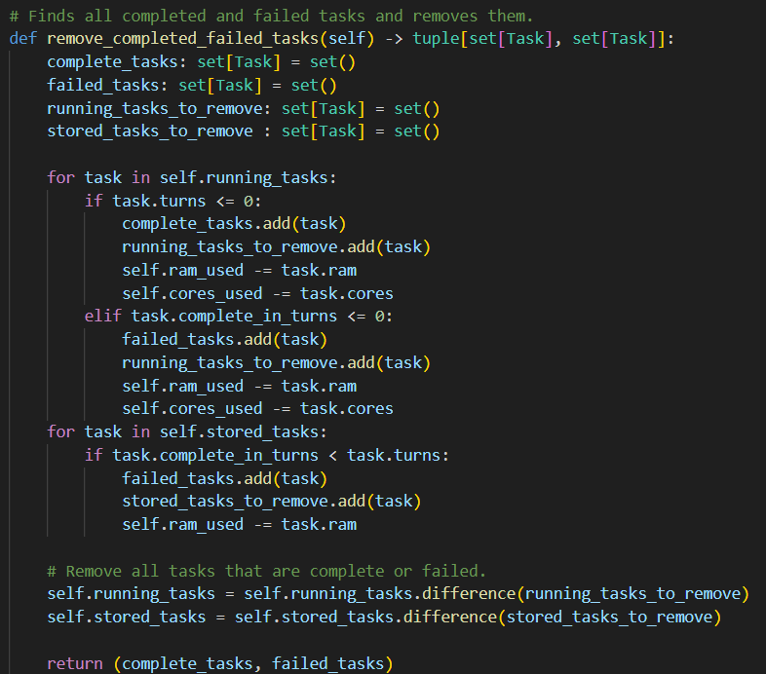
Server.py
Notes:
We also want to remove the completed and failed tasks and get out which of them they are. The implementation is as follows.

Slide 11
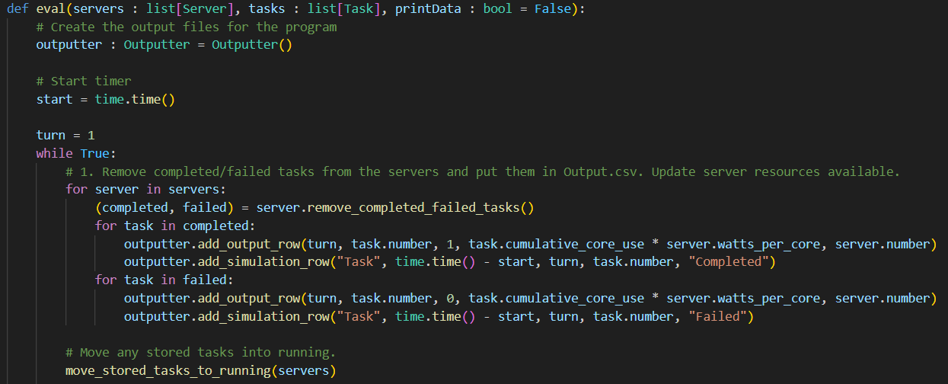
Simulating
Notes:
Our simulation goes through each part from the specification provided.
We first remove any completed/failed tasks from the servers.
For our own purposes, this is where we move stored tasks into our running tasks.

Slide 12
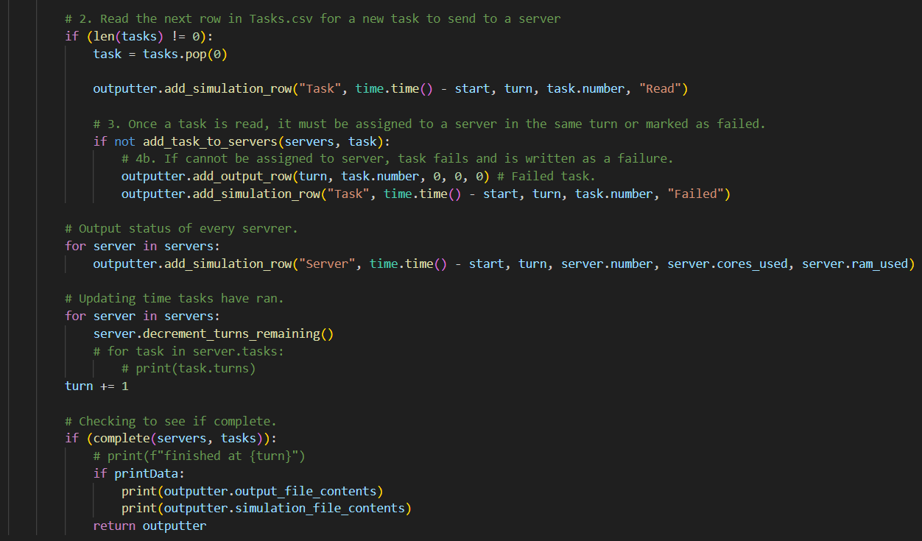
Simulating
Notes:
We then read the next task and try to add it; the implementation of adding it we’ll discuss soon.
If we can’t add the task in we log it as a failure.

Slide 13
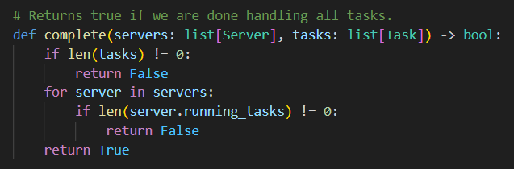
Simulating
Notes:
The code that checks for if the servers are complete just goes through the servers and checks the tasks.

Slide 14
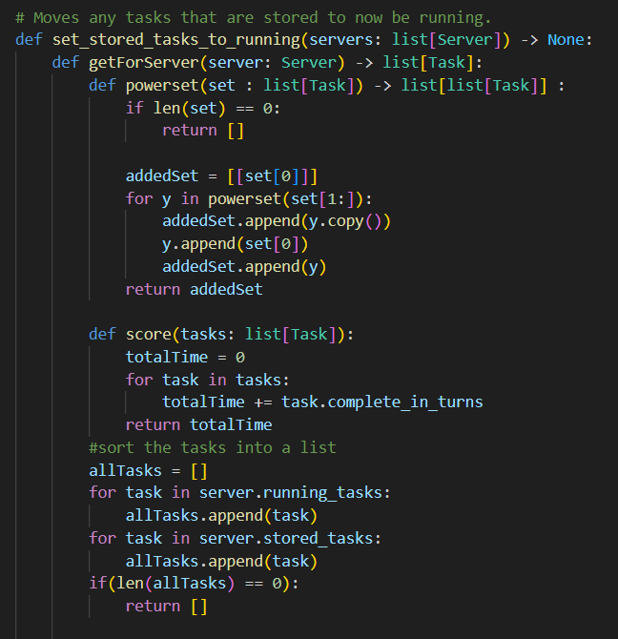
Simulating
Notes:
Jack

Slide 15
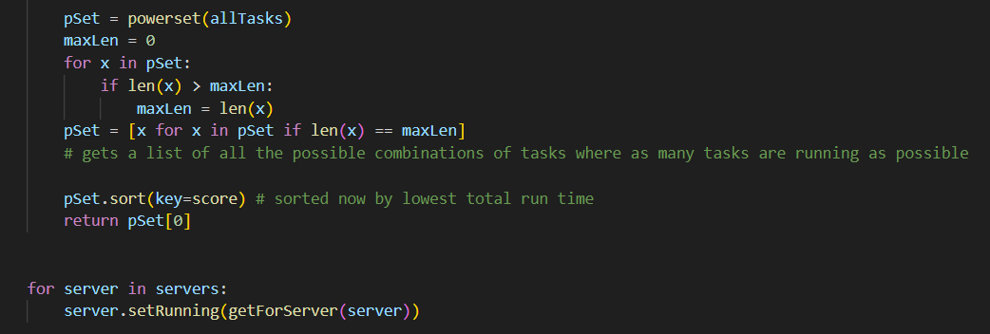
Simulating

Slide 16
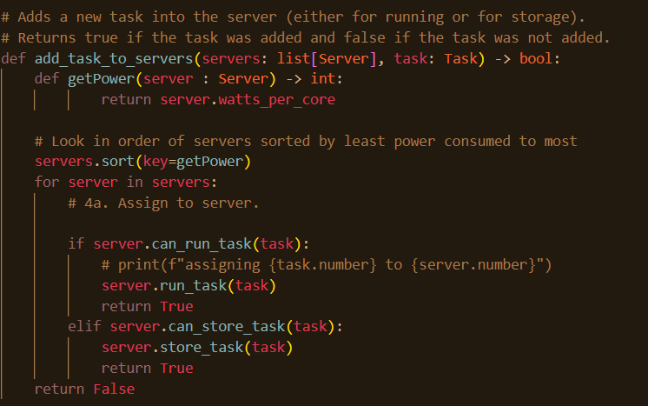
Simulating

Slide 17



Testing
Default algorithm
Default + storage
Power optimization

Slide 18
Testing
thoughts
Default algorithm
Default + storage
Power optimization

Slide 19
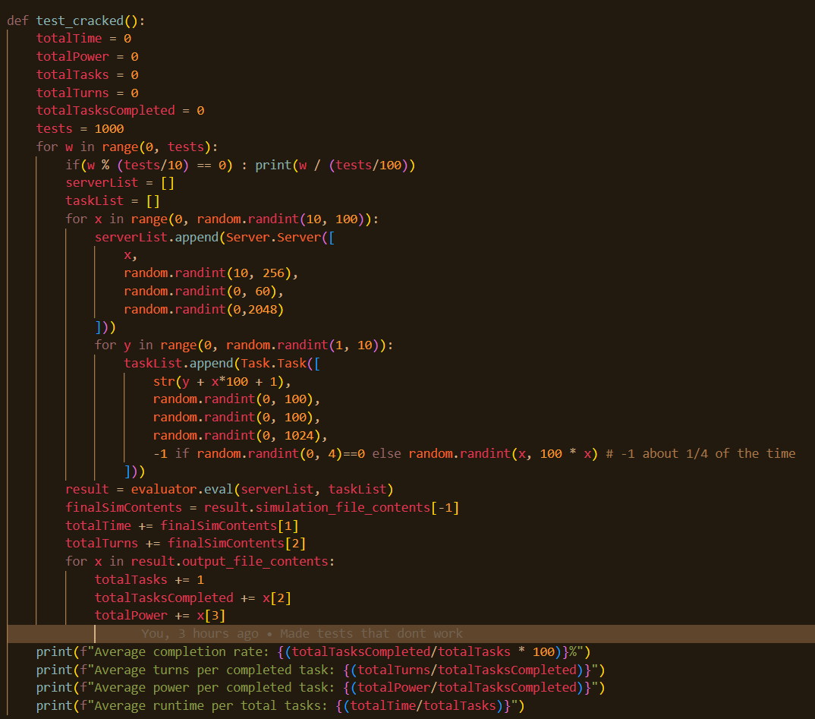
Testing
Notes:
Jack

Slide 20
Outputter.py
add_output_row
Outputter
add_output_row
output_file_contents
write_results
add_simulation_row
simulation_file_contents
add_simulation_row
Notes:
We then want to output our results. We wanted a way to be able to repeatedly call functions to add rows, then later get our output CSV all at once. We achieve this with an Outputter class that has file contents.

Slide 21
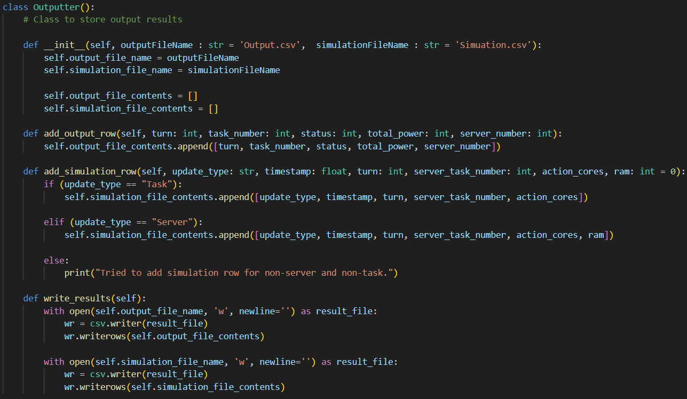
Outputter.py
Notes:
Our implementation looks like follows.
We store our contents as a list, and convert them to CSV files when write_results is called.

